Slide 1
Figure 1
Enrollment criteria and data.
Map of Bangladesh indicating rough location of enrolled patients’ homes
Show % known positive, negative, and mystery

Slide 2
Figure 2A
Inverse Simpsons Diversity
Input RNA (pg)
Increasing CT

Slide 4
Figure 2B
mNGS (RNA+DNA) vs. Conventional,
mNGS (RNA) vs. Conventional
mNGS (DNA) vs. Conventional
mNGS (RNA) vs. mNGS (DNA)

Slide 5
Figure 3
A – Map showing CHIK cases from PCR (surveillance)
C – Sequence similarity to outbreak
B – coverage plots

Slide 6
Figure 4

Slide 7
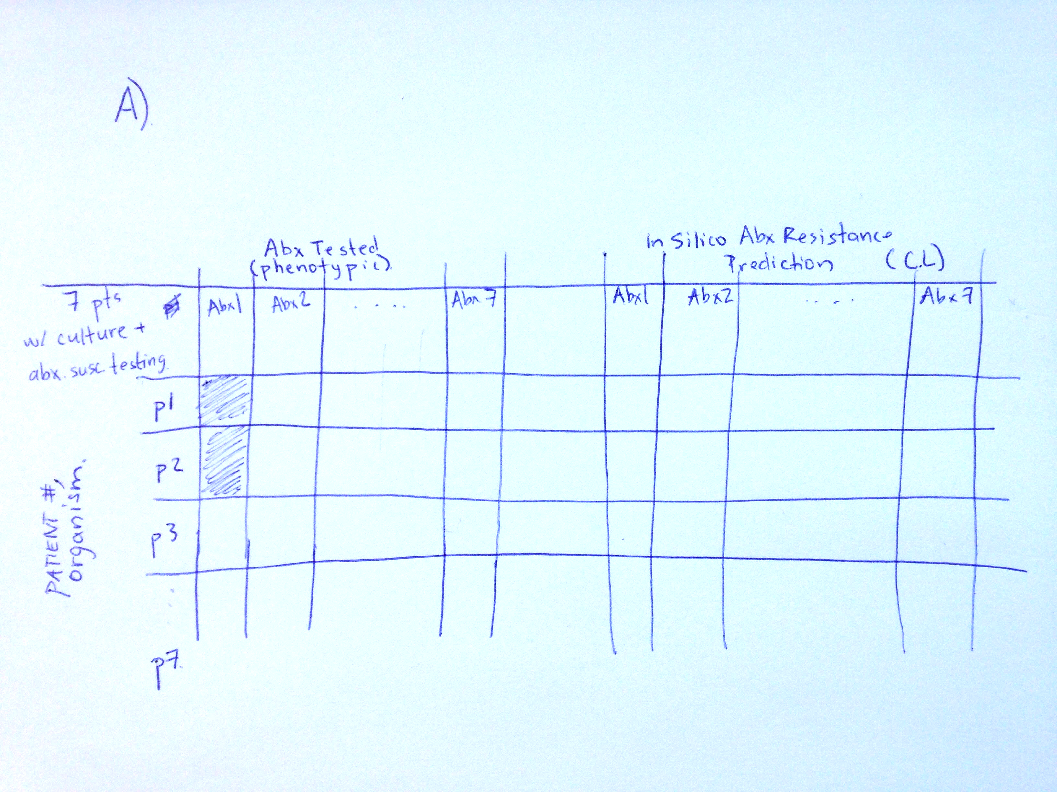
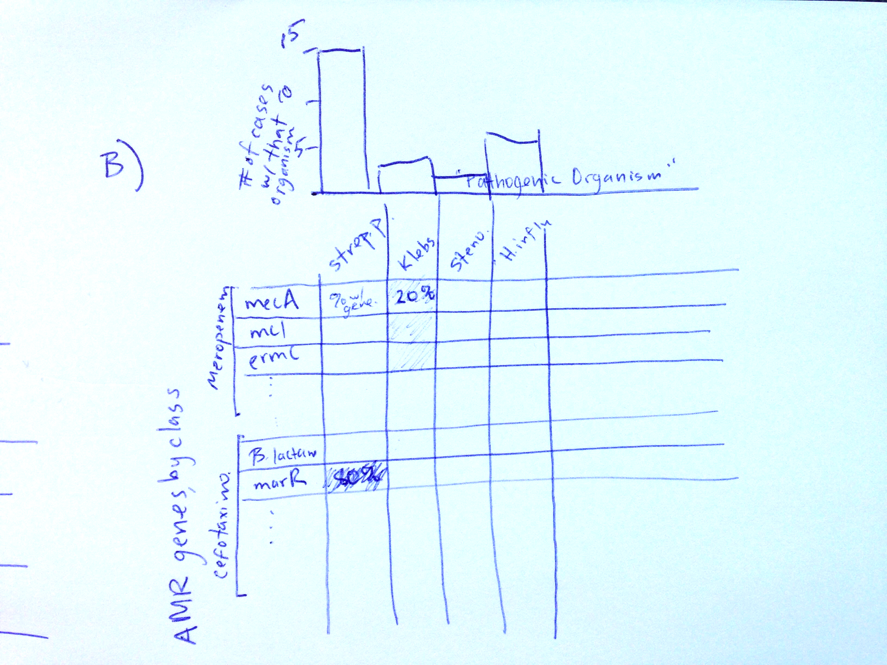
Figure 4 (rough outline)

